Slide 1
CSE251: Electronic Devices and Circuits
Lecture 13 – Zener Diodes
Prepared By:
Shadman Shahid (HAD)
Lecturer, Department of Computer Science and Engineering, School of Data and Sciences, BRAC University
Email: ext.shadman.shahid@bracu.ac.bd

Slide 2
Outline
Voltage Regulators
Forward Bias (FB) Diodes as Voltage Regulators
Drawbacks of (FB) Diodes as Voltage Regulators
Diode Breakdown Region
Zener Diodes – Introduction and analysis
Zener Diodes as Voltage Regulators
Practice Problems

Slide 3
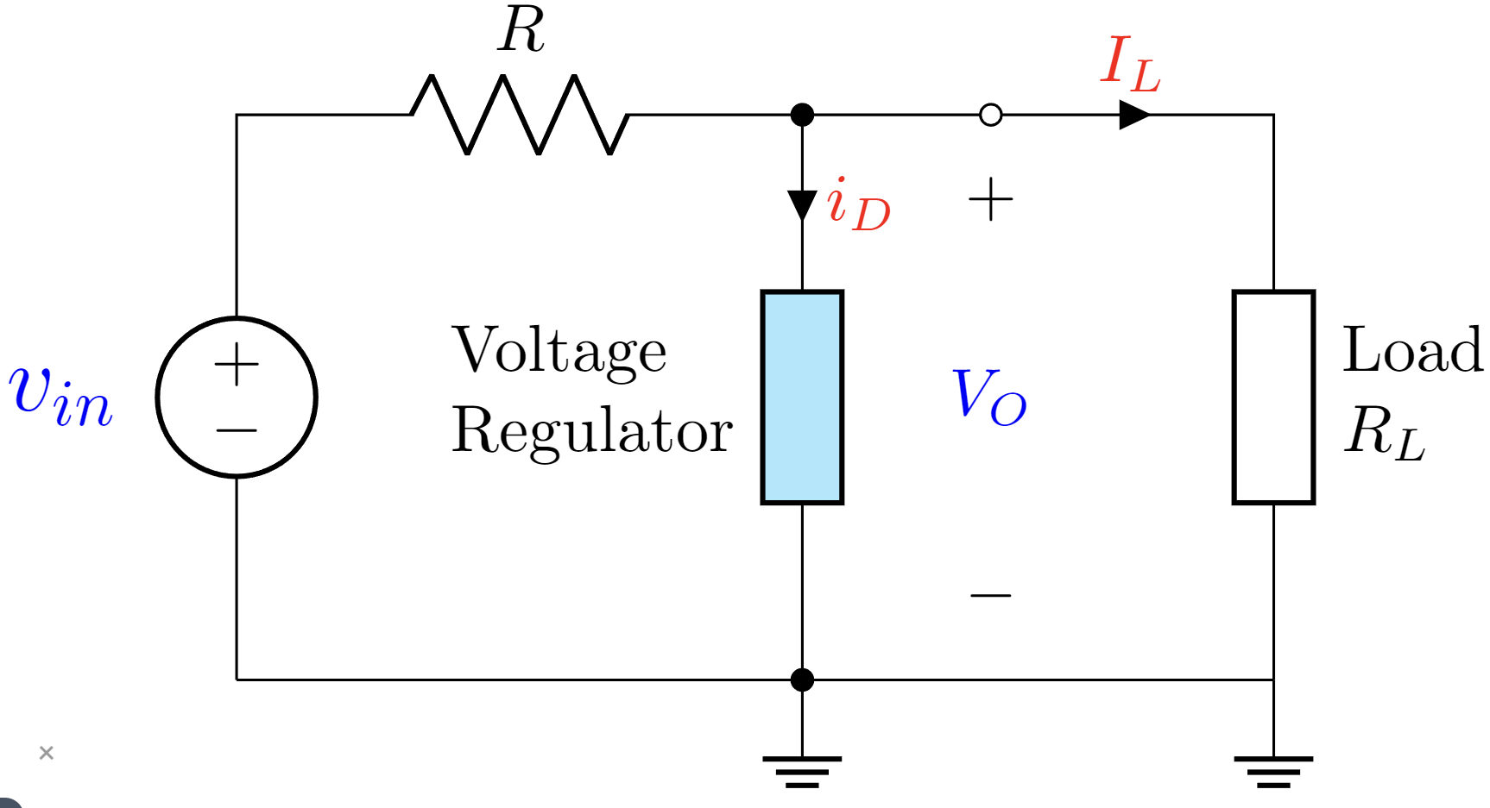
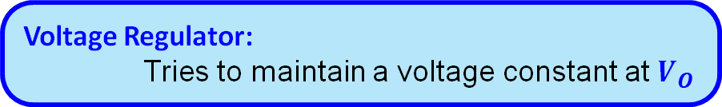
Voltage Regulators
Voltage Regulation is the measure of how well a system can provide near constant voltage.
Voltage Regulators provide steady voltage independent of how much power is drawn from the power source
Voltage Regulator:
Tries to maintain a voltage constant at $V_{O}$

Slide 4





Voltage Regulators
Let’s assume that $v_{in}$ is not a perfect DC source. It supplies a voltage of ${(V}_{DC}±δ) V$
$$v_{in}(V)$$
$$V_{DC}$$
$$δ$$
$$t(s)$$
Voltage Regulator:
Tries to maintain a voltage constant at $V_{O}$
even when $v_{in}$ is varying.
Variables: $V_{O}$ should remain constant irrespective of the changes in the following quantities:
1. Input Voltage: $v_{in}$ 2. Load Current: $I_{L}$ 3. VR current: $i_{D}$

Slide 5
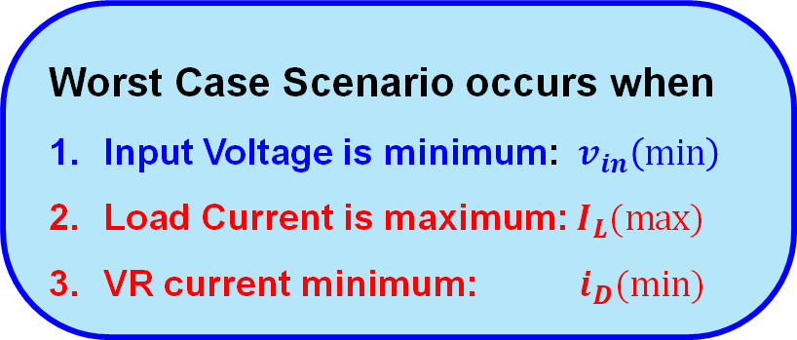
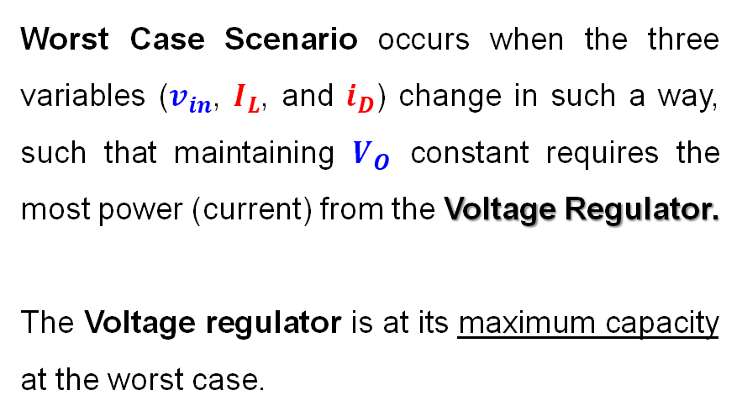
Voltage Regulator – Worst Case Scenario
Worst Case Scenario occurs when the three variables ($v_{in}$, $I_{L}$, and $i_{D}$) change in such a way, such that maintaining $V_{O}$ constant requires the most power (current) from the Voltage Regulator.
The Voltage regulator is at its maximum capacity at the worst case.
Worst Case Scenario occurs when
Input Voltage is minimum: $v_{in}\left(min\right)$
Load Current is maximum: $I_{L}(max)$
VR current minimum: $i_{D}(min)$

Slide 6
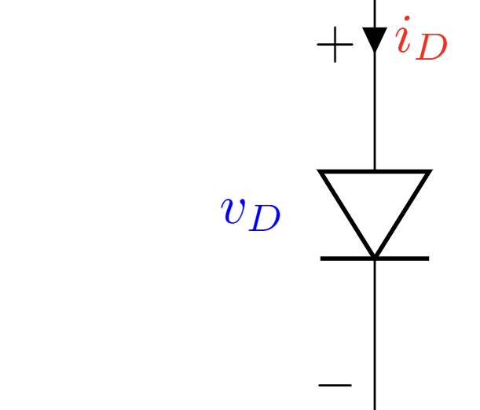
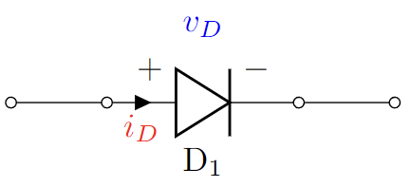
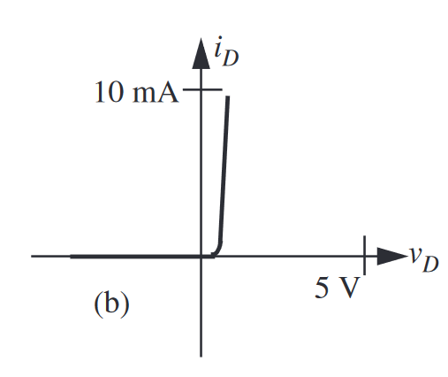
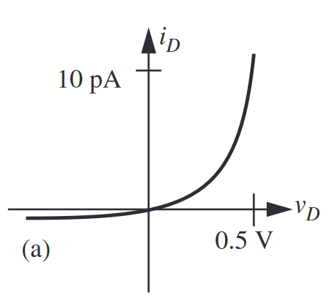
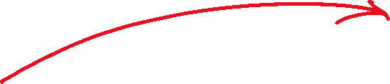
Diodes as Voltage Regulators
Diodes have (IV) characteristics that makes them ideal for voltage regulation.
Exponential IV characteristics of diodes

Slide 7
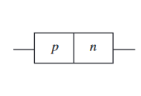
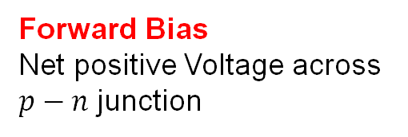
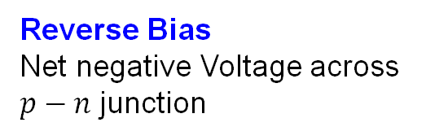
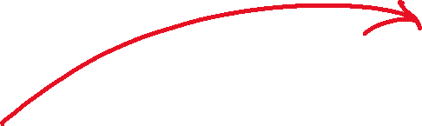

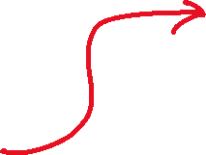
Diodes Revisited
Forward Bias
Net positive Voltage across $p−n$ junction
Physical Schematic:
Reverse Bias
Net negative Voltage across $p−n$ junction
Anode
Cathode
Circuit Schematic:
Exponential IV characteristics of diodes

Slide 8
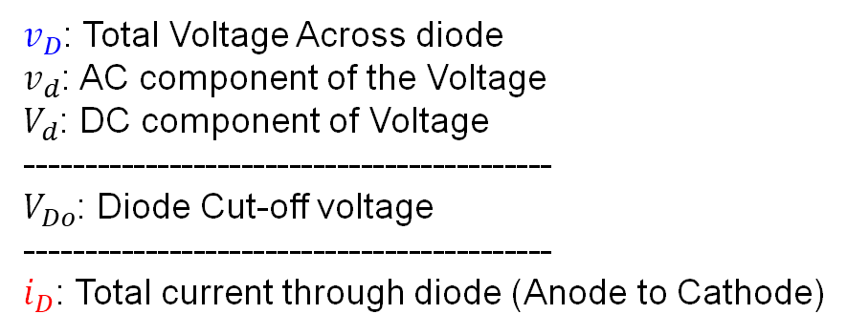


Diodes Revisited
Simple
Ideal Diode Model:
Constant Voltage Drop (CVD) Model:
Voltage Source in Series with Resistor Model (CVD+R) Model
Exponential Model:
Increasing Accuracy
Complex
$v_{D}$: Total Voltage Across diode
$v_{d}$: AC component of the Voltage
$V_{d}$: DC component of Voltage
--------------------------------------------
$V_{Do}$: Diode Cut-off voltage
--------------------------------------------
$i_{D}$: Total current through diode (Anode to Cathode)

Slide 9
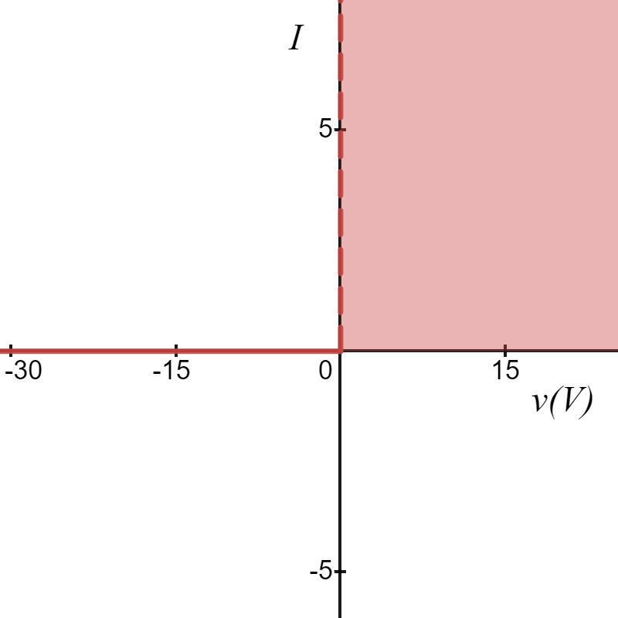
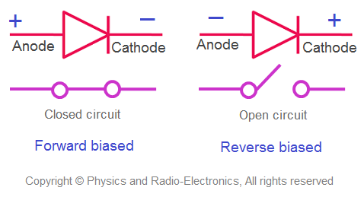





Diode Models
Ideal Diode Model:
$$i_{D}(mA)$$
Forward Bias
$$i_{D}=0$$
$$v_{D}<0$$
$$i_{D}>0$$
$$v_{D}=0$$
$V_{Do}=0$V
Not suitable as
VOLTAGE REGULATOR
$$v_{D}(V)$$
Reverse Bias

Slide 10
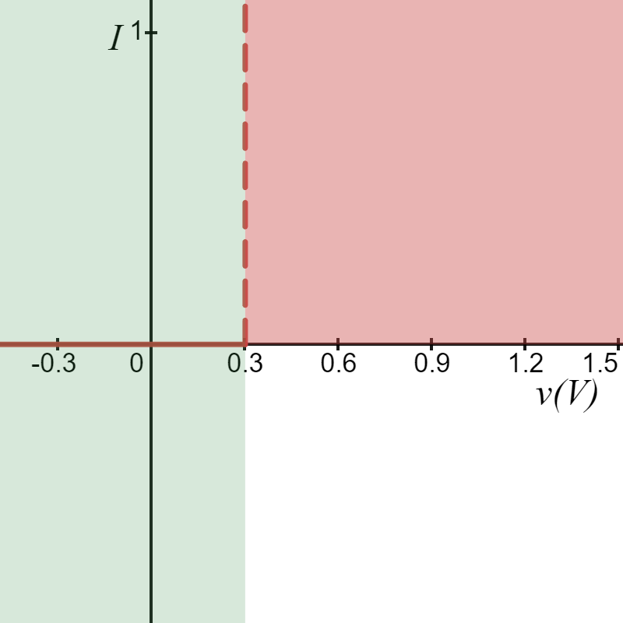
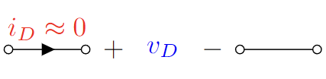
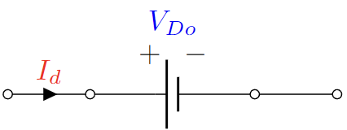





Diode Models
$$i_{D}(mA)$$
2. Constant Voltage Drop (CVD) Model:
Reverse Bias
Forward Bias
$V_{Do}=0.3$V
$$v_{D}(V)$$
Suitable as
VOLTAGE REGULATOR ?
Maybe!
$$i_{D}=0$$
$$v_{D}<V_{Do}$$
$$i_{D}>0$$
$$v_{D}=V_{Do}$$

Slide 11

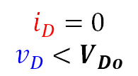
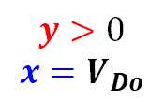
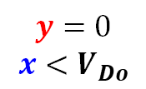
Diode Models
$$i_{D}(mA)$$
2. Constant Voltage Drop (CVD) Model:
Reverse Bias
Forward Bias
$$i_{D}=0$$
$$v_{D}<V_{Do}$$
$$y=0$$
$$x<V_{Do}$$
$$i_{D}>0$$
$$v_{D}=V_{Do}$$
$$y>0$$
$$x=V_{Do}$$
$V_{Do}=0.3$V
$$v_{D}(V)$$
Suitable as
VOLTAGE REGULATOR ?
Maybe!

Slide 12
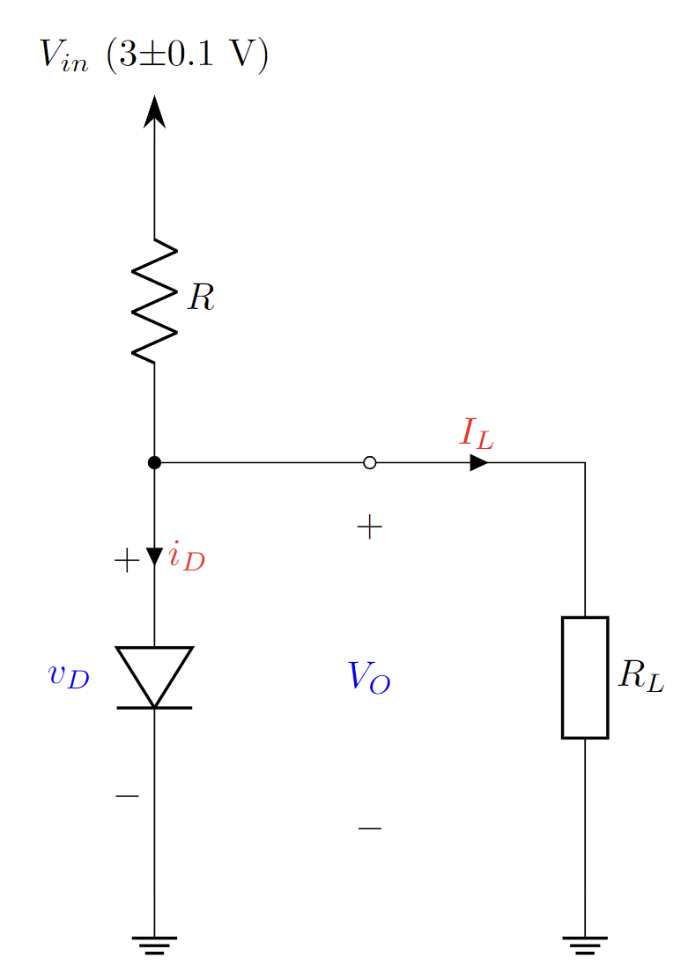
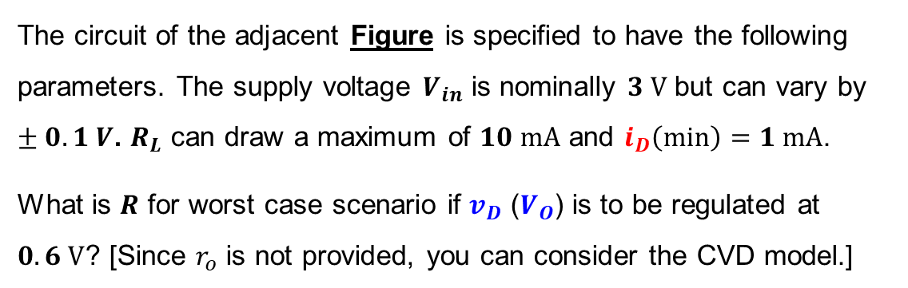



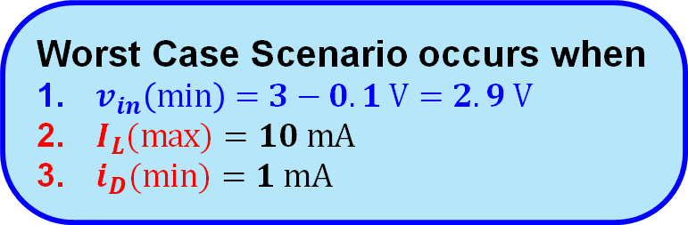



Practice Problem 1
The circuit of the adjacent Figure is specified to have the following parameters. The supply voltage $V_{in}$ is nominally $3 V$ but can vary by $±0.1 V$. $R_{L}$ can draw a maximum of $10 mA$ and $i_{D}\left(min\right)=1 mA$.
What is $R$ for worst case scenario if $v_{D}$ ($V_{O}$) is to be regulated at $0.6 V$? [Since $r_{o}$ is not provided, you can consider the CVD model.]
Solution:
Worst Case Scenario occurs when
$v_{in}\left(min\right)=3−0.1 V=2.9 V$
$I_{L}(max)$ $=10 mA$
$i_{D}(min)$ $=1 mA$

Slide 13
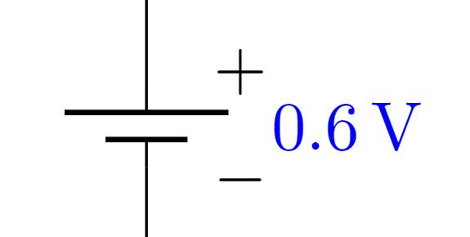
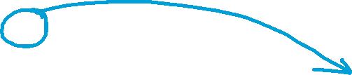






Practice Problem 1
The circuit of the adjacent Figure is specified to have the following parameters. The supply voltage $V_{in}$ is nominally $3 V$ but can vary by $±0.1 V$. $R_{L}$ can draw a maximum of $10 mA$ and $i_{D}\left(min\right)=1 mA$.
What is $R$ for worst case scenario if $v_{D}$ ($V_{O}$) is to be regulated at $0.6 V$? [Since $r_{o}$ is not provided, you can consider the CVD model.]
Solution:

Slide 14
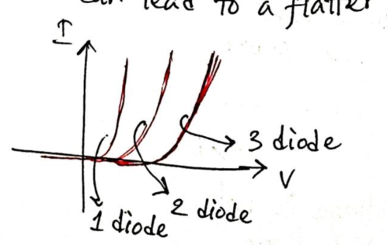
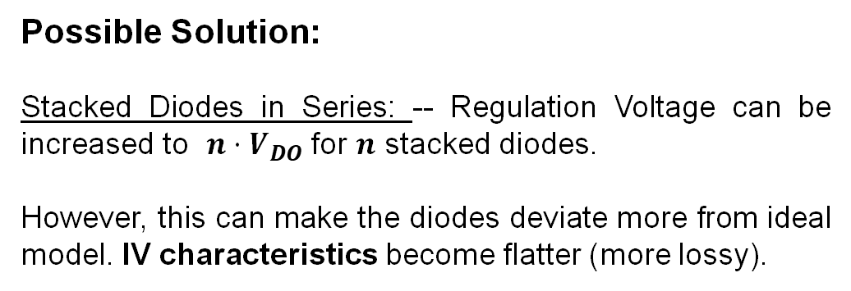
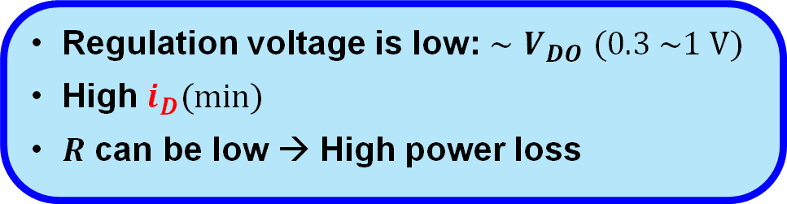
Drawbacks of Diodes as Voltage Regulators
Regulation voltage is low: $∼V_{DO}$ $(0.3 \sim 1 V)$
High $i_{D}(min)$
$R$ can be low → High power loss
Possible Solution:
Stacked Diodes in Series: -- Regulation Voltage can be increased to $n⋅V_{DO}$ for $n$ stacked diodes.
However, this can make the diodes deviate more from ideal model. IV characteristics become flatter (more lossy).

Slide 15
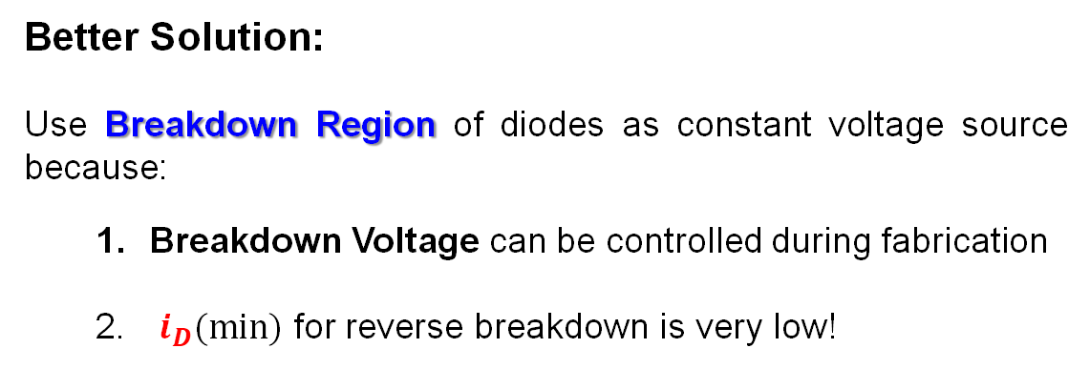
Drawbacks of Diodes as Voltage Regulators
Regulation voltage is low: $∼V_{DO}$ $(0.3 \sim 1 V)$
High $i_{D}(min)$
$R$ can be low → High power loss
Better Solution:
Use Breakdown Region of diodes as constant voltage source because:
Breakdown Voltage can be controlled during fabrication
$i_{D}(min)$ for reverse breakdown is very low!

Slide 16
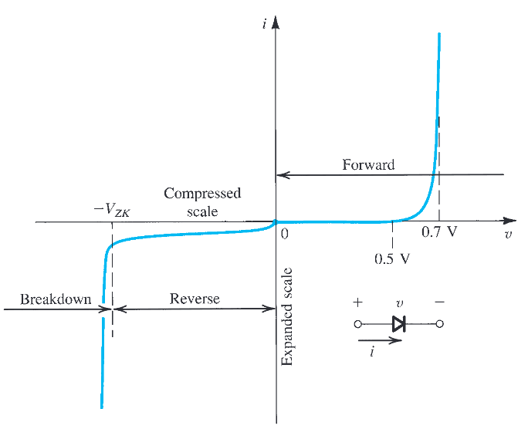

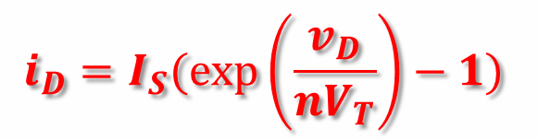


Diode Models
$$i_{D}$$
Forward Bias (FB)
4. Exponential model:
The full IV characteristic
$$i_{D}=I_{S}(exp\left(\frac{v_{D}}{nV_{T}}\right)−1)$$
$$v_{D}$$
Reverse Bias (RB)
$$i_{D}=−I_{S}$$

Slide 17
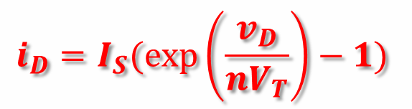




Diode Models
$$i_{D}$$
4. Exponential model:
The full IV characteristic
Forward Bias (FB)
$$i_{D}=I_{S}(exp\left(\frac{v_{D}}{nV_{T}}\right)−1)$$
Reverse Bias (RB)
$${−V}_{ZK}$$
Breakdown
Region
$$v_{D}$$
$$i_{D}=−I_{S}$$
$$?$$

Slide 18






Diode IV Characteristic
Reverse Bias (RB)
$$i_{D}$$
$$i_{D}=−I_{S}$$
$I_{S}$ in this case is the reverse leakage current.
For $v_{D}<V_{DO}$ there is negligible current flow through the diode.
$${I_{S}∼10}^{−15} A$$
$$y={−I}_{S}$$
$$v_{D}$$
Normal diodes cannot tolerate large voltages in reverse bias. Applying large voltages in reverse bias may damage the diode.

Slide 19
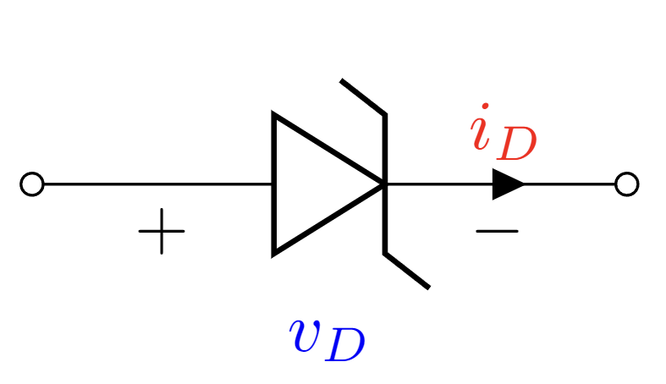





Diode IV Characteristic
Breakdown Region
$$i_{D}$$
Zener Diode
Circuit Symbol
Normal diodes cannot tolerate large voltages in reverse bias. Applying large voltages in reverse bias may damage the diode.
Special classes of diodes exist, that are primed to operate in large reverse bias voltages. These diodes are called
Zener diodes
$${−V}_{ZK}$$
$$I_{ZK}$$
$$v_{D}$$
In this Breakdown region,
the diode acts almost like a
“constant voltage source”.
$$v_{D}<−V_{ZK}$$

Slide 20




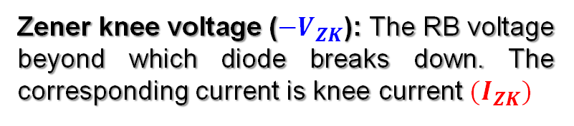

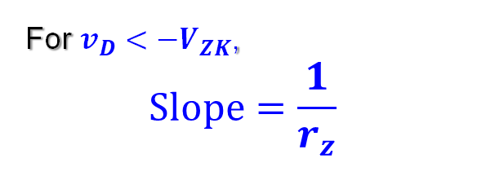
Zener Diode IV
$$i_{D}$$
Breakdown Region
Zener knee voltage ($−V_{ZK}$): The RB voltage beyond which diode breaks down. The corresponding current is knee current ${(I}_{ZK})$
For $v_{D}<−V_{ZK}$,
$$Slope=\frac{1}{r_{z}}$$
$${−V}_{ZK}$$
$$v_{D}<−V_{ZK}$$
$$I_{ZK}$$
$$v_{D}$$
$$Slope=\frac{1}{r_{z}}$$
In this Breakdown region,
the diode acts almost like a
“constant voltage source”.

Slide 21
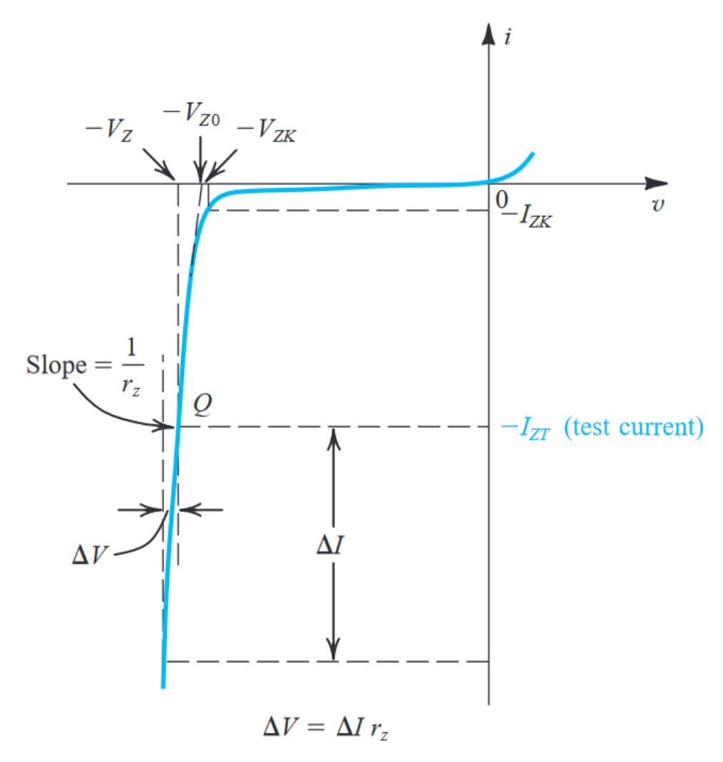
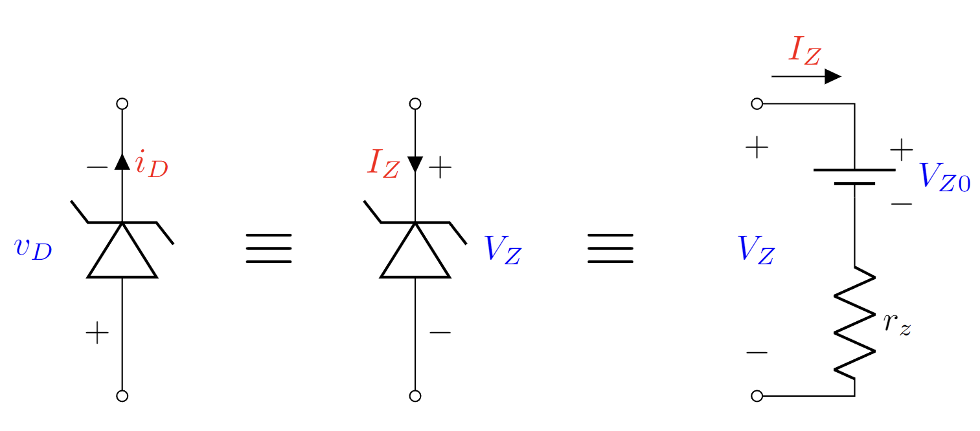





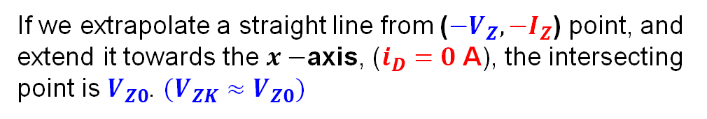

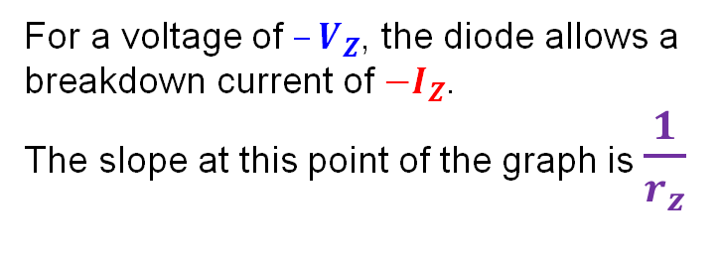
Zener Diode IV
$$i_{D}$$
Breakdown Region
$$v_{D}$$
Since this region is like the forward bias region of a normal diode, we invert the signs of voltage and currents across a Zener diode operating at breakdown voltage, to solve Zener diode circuits in a similar way.
$$v_{D}<−V_{ZK}$$
$$\frac{1}{r_{z}}=\frac{ΔI_{Z}}{ΔV_{Z}}$$
For a voltage of $–V_{Z}$, the diode allows a breakdown current of ${−I}_{Z}$.
The slope at this point of the graph is $\frac{1}{r_{z}}$
$${V_{Z}=−v}_{D}$$
$${I_{Z}=−i}_{D}$$
$$ΔV_{Z}$$
$$ΔI_{Z}$$
If we extrapolate a straight line from ($−V_{Z}, {−I}_{Z}$) point, and extend it towards the $x−$axis, ($i_{D}=0$ A), the intersecting point is $V_{Z0}$. $(V_{ZK}≈V_{Z0})$

Slide 22











Zener Diode IV
$$I_{Z}=−i_{D}$$
Breakdown Region
$${(V_{Z}>V}_{Z0}≈V_{ZK})$$
$$ΔI_{Z}$$
$$ΔV_{Z}$$
$$V_{Z}=V_{Z0}+I_{Z}r_{z}$$
$$Slope=\frac{1}{r_{z}}=\frac{ΔI_{Z}}{ΔV_{Z}}$$
$$I_{ZK}$$
$$V_{Z}=−v_{D}$$
$$V_{Z0}$$
$$V_{ZK}$$
$$V_{Z}$$
In this Breakdown region, the diode acts almost like a
“constant voltage source”.

Slide 23












Zener Diode Breakdown IV Characteristic
Breakdown Region
$${(V_{Z}>V}_{Z0}≈V_{ZK})$$
$$I_{Z}$$
$$V_{Z}=V_{Z0}+I_{Z}r_{z}$$
$$Slope:$$
$$m=\frac{1}{r_{z}}$$
Reverse Bias Region
$$I_{ZK}$$
$${(V_{Z}<V}_{Z0}≈V_{ZK})$$
$$V_{Z}$$
$$V_{Z0}=20 V$$
$$I_{Z}=I_{ZK}$$
$V_{Z}$: Total RB Voltage Across Zener diode
--------------------------------------------
$V_{Z0}$: Zener knee voltage

Slide 24




Practice Problem 2
The $6.8−V$ Zener diode in the circuit of Figure is specified to have the following parameters. The supply voltage $V^{+}$ is nominally $10 V$ but can vary by $±1 V$.
Find $V_{0}$ with no load and with $V^{+}$ at its nominal value
(For $R_{L}=0.5 kΩ$). Find the $I_{Z}$. In this scenario, calculate the Zener voltage $V_{O}$, load current $I_{L}$ and input current $I$
Find the $R_{L}$ that would give rise to worst-case scenario at worst case $V^{+}$. In this worst-case scenario, calculate the Zener voltage $V_{Z}$, load current $I_{L}$ and input current $I$
(For $R_{L}=2 kΩ$). Find the $I_{Z}$. In this scenario, calculate the Zener voltage $V_{O}$, load current $I_{L}$ and input current $I$
Design the circuit, i.e., find the minimum value of the input voltage $V^{+}$ such that, voltage regulation is maintained even in the worst-case scenario for $R_{L}=2 kΩ$. (Forget that $V^{+}$is 10 V)
Determine whether the circuit will maintain regulation if $V^{+}$ is increased. If yes, argue if it should be increased or not.
$V^{+}=10±1$V
---------------------------
$V_{Z} = 6.8 V$ at $I_{Z} = 5 mA$
$r_{z} = 20 Ω$.
$I_{ZK} = 0.2 mA$.

Slide 25



Practice Problem 2
$V^{+}=10±1$V
$V_{Z1} = 6.8 V$ at $I_{Z1} = 5 mA$
$r_{z} = 20 Ω=0.02 kΩ$.
$I_{ZK} = 0.2 mA$.
The $6.8−V$ Zener diode in the circuit of Figure is specified to have the following parameters. The supply voltage $V^{+}$ is nominally $10 V$ but can vary by $±1 V$.
Find $V_{0}$ with no load and with $V^{+}$ at its nominal value

Slide 26





Practice Problem 2
The $6.8−V$ Zener diode in the circuit of Figure is specified to have the following parameters. The supply voltage $V^{+}$ is nominally $10 V$ but can vary by $±1 V$.
$V^{+}=10±1$V
$V_{Z1} = 6.8 V$ at $I_{Z1} = 5 mA$
$r_{z} = 20 Ω=0.02 kΩ$.
$I_{ZK} = 0.2 mA$.
Find $V_{0}$ with no load and with $V^{+}$ at its nominal value
Solution:
Extracting Zener diode ‘s reverse cut-in voltage
$$V_{ZO}=6.8 −5×0.02 V$$
$$∴V_{ZO}=6.7 V$$
----------------------------------
Determining current from the 10 V source
$$I=\frac{\begin{aligned} \\ \end{aligned}}{}$$
$$I=\frac{10−6.7}{0.5+0.02}mA=6.346 mA$$
----------------------------------
Determining output voltage
$$V_{O}=6.7+6.346×0.02 V$$
$$V_{O}=6.82692 V$$

Slide 27


Practice Problem 2
The $6.8−V$ Zener diode in the circuit of Figure is specified to have the following parameters. The supply voltage $V^{+}$ is nominally $10 V$ but can vary by $±1 V$.
$V^{+}=10±1$V
$V_{Z} = 6.8 V$ at $I_{Z} = 5 mA$
$$V_{ZO}=6.7 V$$
$r_{z} = 20 Ω$.
$I_{ZK} = 0.2 mA$.
(b) (For $R_{L}=0.5 kΩ$). Find the $I_{Z}$. In this scenario, calculate the Zener voltage $V_{O}$, load current $I_{L}$ and input current $I$
Solution:

Slide 28


Practice Problem 2
The $6.8−V$ Zener diode in the circuit of Figure is specified to have the following parameters. The supply voltage $V^{+}$ is nominally $10 V$ but can vary by $±1 V$.
$V^{+}=10±1$V
$V_{Z} = 6.8 V$ at $I_{Z} = 5 mA$
$$V_{ZO}=6.7 V$$
$r_{z} = 20 Ω$.
$I_{ZK} = 0.2 mA$.
(b) (For $R_{L}=0.5 kΩ$). Find the $I_{Z}$. In this scenario, calculate the Zener voltage $V_{O}$, load current $I_{L}$ and input current $I$
Solution:
Solving the node equation at $V_{O}.$
$$\frac{(10±1)−V_{O}}{R}=\frac{V_{O}−V_{ZO}}{r_{z}}+\frac{V_{O}}{R_{L}}$$
$$\frac{(10±1)−V_{O}}{0.5}=\frac{V_{O}−6.7}{0.02}+\frac{V_{O}}{0.5}$$
$$∴V_{O}=6. 537∼6.611 V$$
As, $V_{O}<V_{ZO}$, the Zener diode will not be in reverse breakdown mode, but in cut off
$$I_{Z}=I_{ZK}$$

Slide 29



Practice Problem 2
The $6.8−V$ Zener diode in the circuit of Figure is specified to have the following parameters. The supply voltage $V^{+}$ is nominally $10 V$ but can vary by $±1 V$.
$V^{+}=10±1$V
$V_{Z} = 6.8 V$ at $I_{Z} = 5 mA$
$$V_{ZO}=6.7 V$$
$r_{z} = 20 Ω$.
$I_{ZK} = 0.2 mA$.
(b) (For $R_{L}=0.5 kΩ$). Find the $I_{Z}$. In this scenario, calculate the Zener voltage $V_{O}$, load current $I_{L}$ and input current $I$
Solution:
$$∴V_{O}=6. 537∼6.611 V$$
As, $V_{O}<V_{ZO}$, the Zener diode will not be in reverse breakdown mode, but in cut off
$$I_{Z}=I_{ZK}$$
So,
$$V_{O}\left(\frac{1}{0.5}+\frac{1}{0.5}\right)=\frac{10±1}{0.5}−0.2$$
$$V_{O}=4.95±0.5 V$$
$$I_{L}=\frac{V_{O}}{R_{L}}=\frac{4.95±0.5 }{0.5} mA=9.9±1 mA$$
$$I_{ZK}$$

Slide 30


(c) Find the $R_{L}$ that would give rise to worst-case scenario at worst case $V^{+}$. In this worst-case scenario, calculate the Zener voltage $V_{Z}$, load current $I_{L}$ and input current $I$
(d) (For $R_{L}=2 kΩ$). Find the $I_{Z}$. In this scenario, calculate the Zener voltage $V_{O}$, load current $I_{L}$ and input current $I$

Slide 31
(e) Design the circuit, i.e., find the minimum value of the input voltage $V^{+}$ such that, voltage regulation is maintained even in the worst-case scenario for $R_{L}=2 kΩ$. (Forget that $V^{+}$is 10 V)

Slide 32


Solving Problems
Modifiable
Parameters
Circuit parameters .
$R$, $R_{L}$
Zener diode parameters
$V_{Z0}$.
$r_{z}$
Worst-Case Parameters
$I_{ZK}$
Fixed
Parameters

Slide 33



Obtain the Fixed Parameters first
$$V_{O}=V_{ZO}+I_{Z}r_{z}$$
$$I_{Z}=\frac{V_{O}−V_{ZO}}{r_{z}}$$
KCL/Nodal Analysis at node $V_{O}$
$$\frac{{ v}_{in}−V_{O}}{R}=I_{Z}+\frac{V_{O}}{R_{L}}$$
$$\frac{{ v}_{in}−V_{O}}{R}=\frac{V_{O}−V_{ZO}}{r_{z}}+\frac{V_{O}}{R_{L}}$$

Slide 34








Measures of Worst-Case Scenario (General)
Solving:
Minimum Current through VR:
$$I_{Z}(min)≥I_{ZK}$$
$$V_{O}=V_{ZO}+I_{Z}r_{z}$$
$$I_{Z}=\frac{V_{O}−V_{ZO}}{r_{z}}$$
$$\frac{V_{O}−V_{ZO}}{r_{z}}≥I_{ZK}$$
$$V_{O}≥V_{ZO}+I_{ZK}r_{z}$$
Minimum Input Voltage:
$$v_{in}\left(min\right)>V_{ZO}+I_{ZK}\left(r_{z}+R\right)+I_{L}R$$
Worst Case Scenario occurs when
Input Voltage is minimum: $v_{in}\left(min\right)$
Load Current is maximum: $I_{L}(max)$
VR current minimum: $I_{Z}(min)$
Maximum Load Current
$$I_{L}\left(max\right)≤\frac{{ v}_{in}−V_{O}}{R}−I_{ZK}$$

Slide 35



Measures of Voltage Regulation
There are two quantities that grade the performance of voltage regulator.
Load Regulation: Change in output voltage $V_{O}$ per unit change in load current $I_{L}$. ($v_{in}$ is fixed)
Line Regulation: Change in output voltage $V_{O}$ per unit change in supply voltage $v_{in}$. ($R_{L}$ is fixed)
Mathematically Load Regulation is $\frac{dV_{O}}{dI_{L}}$
Mathematically Line Regulation is $\frac{dV_{O}}{dv_{in}}$

Slide 36






Measures of Voltage Regulation
Measuring Line Regulation:
$$\frac{{ v}_{in}−V_{O}}{R}=I_{Z}+\frac{V_{O}}{R_{L}}$$
$$\frac{{ v}_{in}−V_{O}}{R}=\frac{V_{O}−V_{ZO}}{r_{z}}+\frac{V_{O}}{R_{L}}$$
$$V_{O}=V_{ZO}+I_{Z}r_{z}$$
$$I_{Z}=\frac{V_{O}−V_{ZO}}{r_{z}}$$
$$V_{O}\left(\frac{1}{R}+\frac{1}{r_{z}}+\frac{1}{R_{L}}\right)=v_{in}\left(\frac{1}{R}\right)+V_{ZO}\left(\frac{1}{r_{z}}\right)$$
$$\frac{V_{O}}{R\left|\left|r_{z}\right|\right|R_{L}}=v_{in}\left(\frac{1}{R}\right)+V_{ZO}\left(\frac{1}{r_{z}}\right)$$
Express $V_{O}$ as a function of $v_{in}$.

Slide 37



Measures of Voltage Regulation
Measuring Line Regulation:
$$V_{O}=v_{in}\left(\frac{R\left|\left|r_{z}\right|\right|R_{L}}{R}\right)+V_{ZO}\left(\frac{R\left|\left|r_{z}\right|\right|R_{L}}{r_{z}}\right)$$
$$V_{O}\left(\frac{1}{R}+\frac{1}{r_{z}}+\frac{1}{R_{L}}\right)=v_{in}\left(\frac{1}{R}\right)+V_{ZO}\left(\frac{1}{r_{z}}\right)$$
$$\frac{V_{O}}{R\left|\left|r_{z}\right|\right|R_{L}}=v_{in}\left(\frac{1}{R}\right)+V_{ZO}\left(\frac{1}{r_{z}}\right)$$
Express $V_{O}$ as a function of $v_{in}$.
$$\frac{dV_{O}}{dv_{in}}= \frac{R\left|\left|r_{z}\right|\right|R_{L}}{R}$$

Slide 38




Measures of Voltage Regulation
Measuring Load Regulation:
$$\frac{{ v}_{in}−V_{O}}{R}=I_{Z}+I_{L}$$
$$\frac{{ v}_{in}−V_{O}}{R}=\frac{V_{O}−V_{ZO}}{r_{z}}+I_{L}$$
$$V_{O}=V_{ZO}+I_{Z}r_{z}$$
$$I_{Z}=\frac{V_{O}−V_{ZO}}{r_{z}}$$
$$V_{O}\left(\frac{1}{R}+\frac{1}{r_{z}}\right)=−I_{L}+v_{in}\left(\frac{1}{R}\right)+V_{ZO}\left(\frac{1}{r_{z}}\right)$$
$$\frac{V_{O}}{R||r_{z}}=−I_{L}+v_{in}\left(\frac{1}{R}\right)+V_{ZO}\left(\frac{1}{r_{z}}\right)$$
Express $V_{O}$ as a function of $I_{L}$.
$$\frac{dV_{O}}{dI_{L}}=−R||r_{z}$$

Slide 39

Measures of Voltage Regulation
Measuring Load Regulation:
$$V_{O}=v_{in}\left(\frac{R\left|\left|r_{z}\right|\right|R_{L}}{R}\right)+V_{ZO}\left(\frac{R\left|\left|r_{z}\right|\right|R_{L}}{r_{z}}\right)$$
$$V_{O}\left(\frac{1}{R}+\frac{1}{r_{z}}+\frac{1}{R_{L}}\right)=v_{in}\left(\frac{1}{R}\right)+V_{ZO}\left(\frac{1}{r_{z}}\right)$$
$$\frac{V_{O}}{R\left|\left|r_{z}\right|\right|R_{L}}=v_{in}\left(\frac{1}{R}\right)+V_{ZO}\left(\frac{1}{r_{z}}\right)$$
$$\frac{dV_{O}}{dv_{in}}= \frac{R\left|\left|r_{z}\right|\right|R_{L}}{R}$$

Slide 40




Practice Problem 3
The Zener diode in the circuit of Figure is specified to have the following parameters. The supply voltage $V_{in}$ is nominally $5 V$ but can vary by $±10 \%$. Load current can vary from $0 mA$to $50 mA$.
$V_{in}=5 V±10 \%$
-----------------------
$V_{Z0} =3 V$
$r_{z} = 0 Ω$
$I_{ZK} =1 mA$.
Find minimum and maximum input Voltage, $V_{in}\left(min\right)$ and $V_{in}\left(max\right)$, maximum and minimum load current $I_{L}(max)$ and $I_{L}(min)$, minimum diode current $I_{Z}(min)$.
Find the $I_{Z}$, $V_{in}$ and $I_{L}$ at worst-case scenario.
For worst case what is $I_{S}$ and $V_{R}$.
Find $R$ for which diode maintains regulation at worst case scenario

Slide 41



Practice Problem 4
The Zener diode in the circuit of Figure is specified to have the following parameters.
$V_{Z0} =3 V$
$r_{z} =20 Ω$, $0 Ω$
$I_{ZK} =1 mA$.
Find minimum input voltage, $V_{in}\left(min\right)$ for which the diode maintains regulation, when $R_{L}=10 kΩ$.
Find worst case $R_{L}$ if the input voltage $V_{in}$ is nominally $5 V$ but can vary by $±10 \%$

Slide 42

Some important tips
If $V_{ZK}$, $V_{ZO}$ and $r_{Z}$ are given, we can calculate $I_{ZK}=\frac{V_{ZK}−V_{ZO}}{r_{z}}$
If $V_{ZO}$ and $r_{Z}$ are not provided, consider $V_{ZK}=V_{Z}=V_{ZO}$
Consider $I_{ZK}=0$ if not provided

